Slide 1
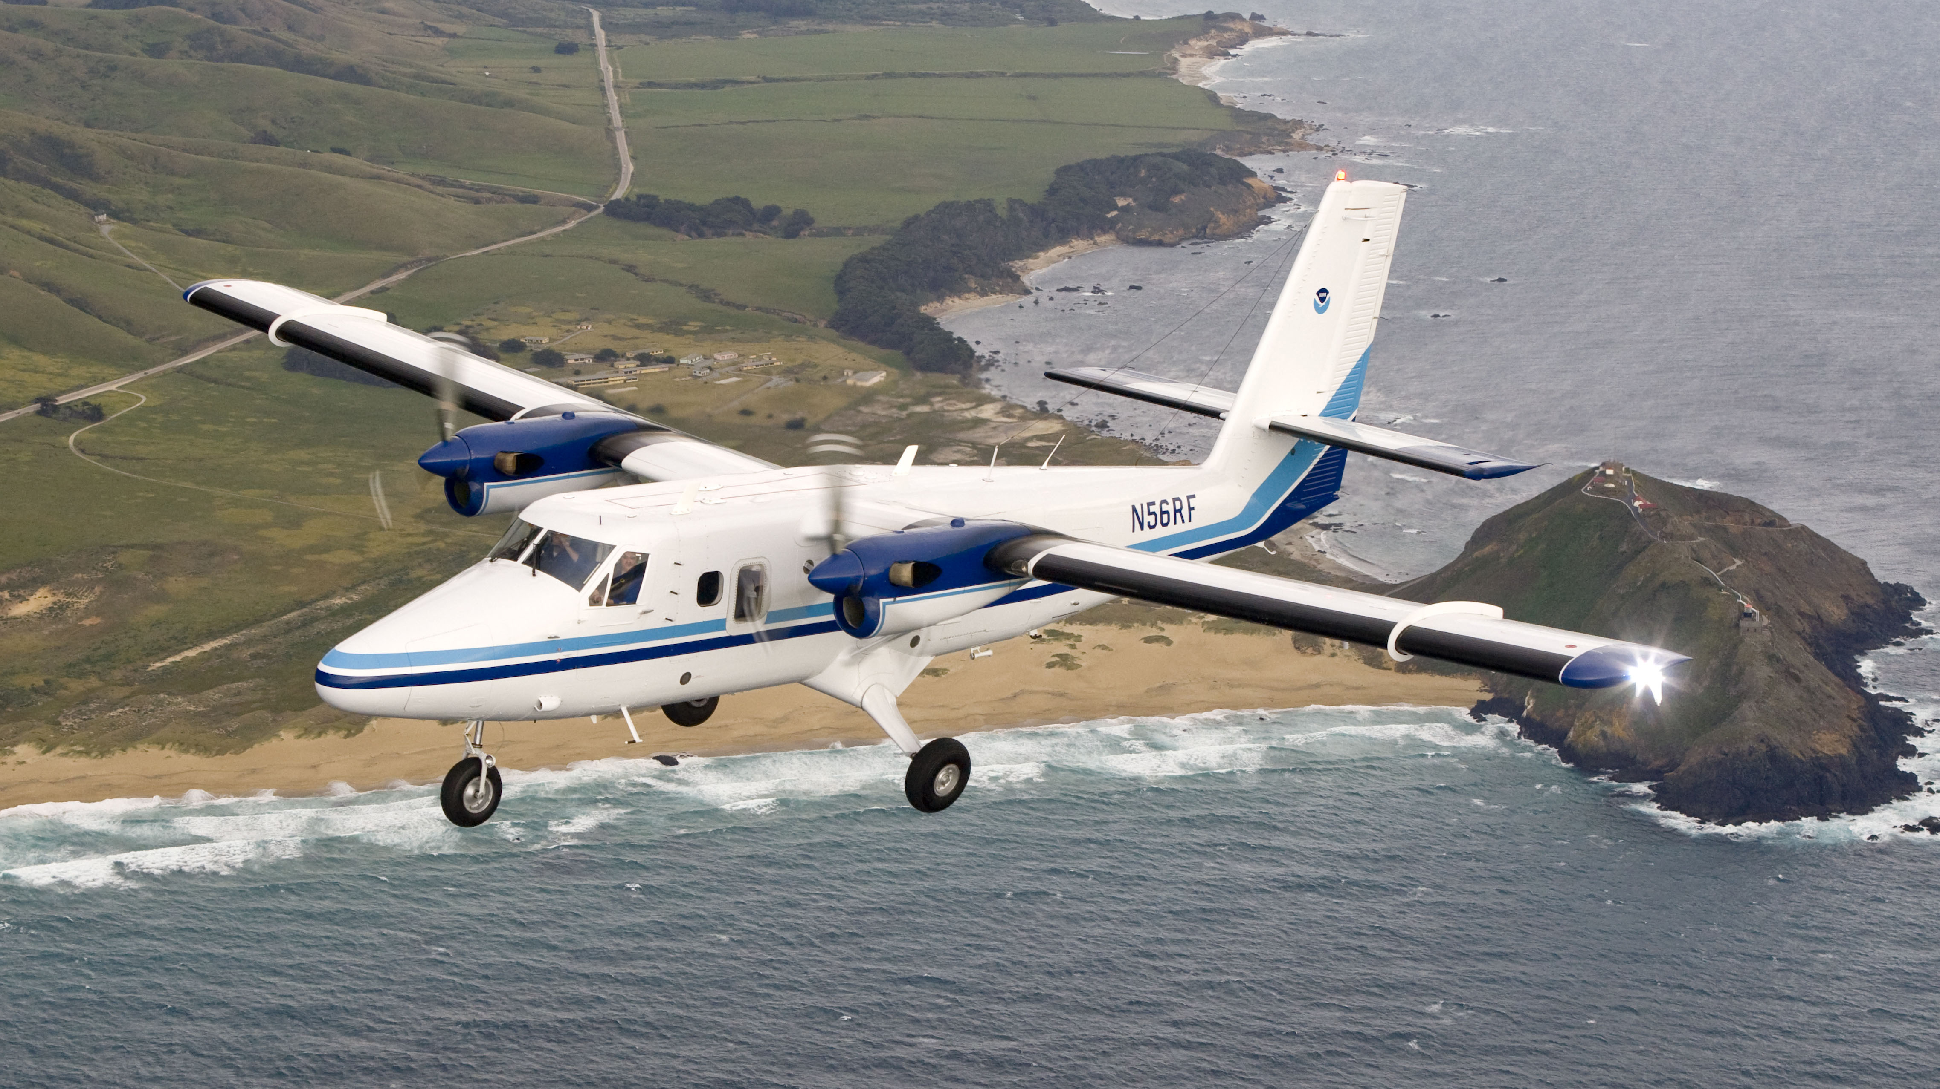
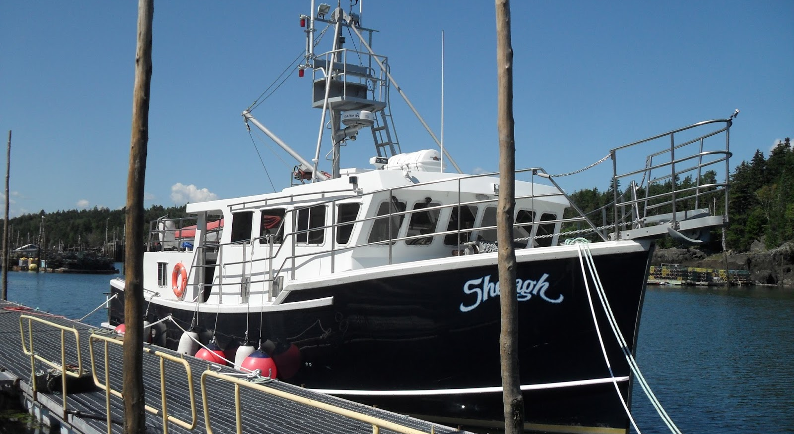
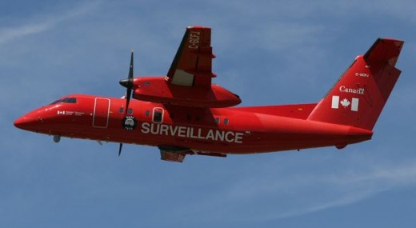
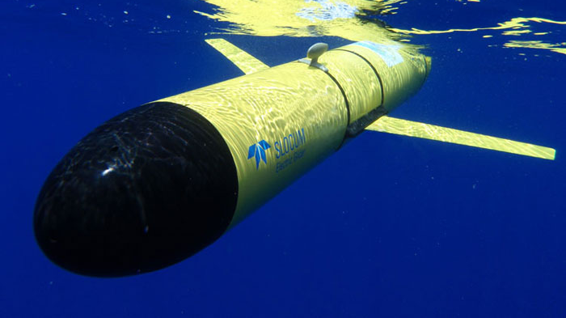
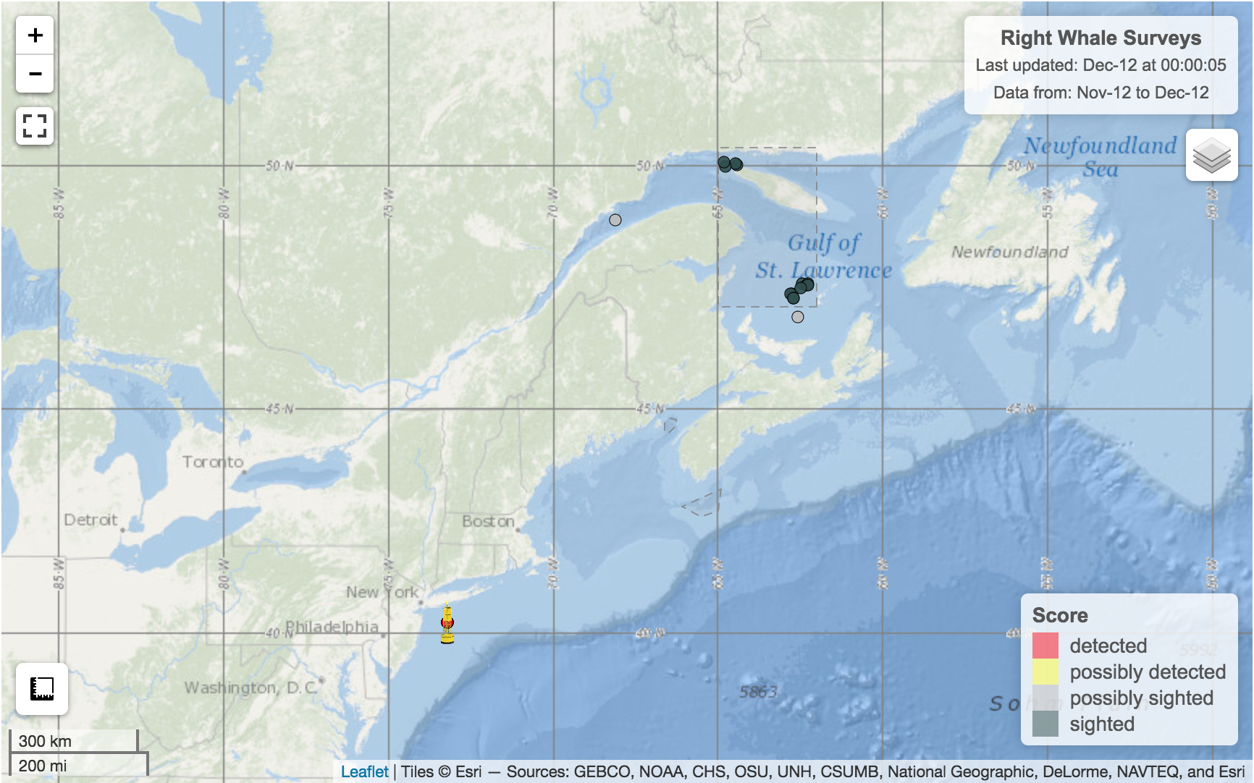
Survey
NOAA_Twin_Otter
Shelagh_vessel
TC_Dash-8
DFO_Twin_Otter
dcs.whoi.edu
Data repository
DATA
NOAA_Twin_Otter
Shelagh_vessel
TC_Dash-8
DFO_Twin_Otter
dcs.whoi.edu
Dalhousie server
(updates every ~5 min)
Database
Webserver
Website
Public (only QC data)
Internal (includes raw data)

